Slide 1
OUTSHIPPER PRIVATE LIMITED
CORPORATE BROCHURE

Slide 2
Introduction
Outshipper Private Limited is founded by Mr. Umesh Kumar in 2020. Mr. Verma is having more than 15 years experience in logistics sector and have worked most popular companies like Rivigo services private limited , Delhivery Ltd, Startrack private Limited, Future Supply chain etc. OUTSHIPPER PRIVATE LIMITED was born December 2020 from the need to have specialized end-to-end Supply Chain solutions for the Consumption products. Over the years, OUTSHIPPER PRIVATE LIMITED has developed competencies in managing the various operations that constitute the Supply Chains across all the consumption product categories.

Slide 3
Milestone
Started 2020
Commenced operation FTL 2020
Commenced operation PTL 2021
Commenced warehousing 2022
Commenced NCR same day services 2023
Commenced Aggregator Platform shipcozy 2024

Slide 4
Strength
200 owned vehicle
100 + employees
20 + Branches in Delhi NCR and Haryana
100 + Associate Partner
200+ Associate vendor
Unbelievable technology
100 + onboarded customer

Slide 5
Services
Part truck Load
Full truck Load
NCR Same day
NCR next day
Warehousing
E-commerce solution

Slide 6
Solution
24x 7 support
Rate calculator
COD remittance Dashboard
Bulk order process
Live tracking
Multi carrier partner
NDR management
API Integration

Slide 7
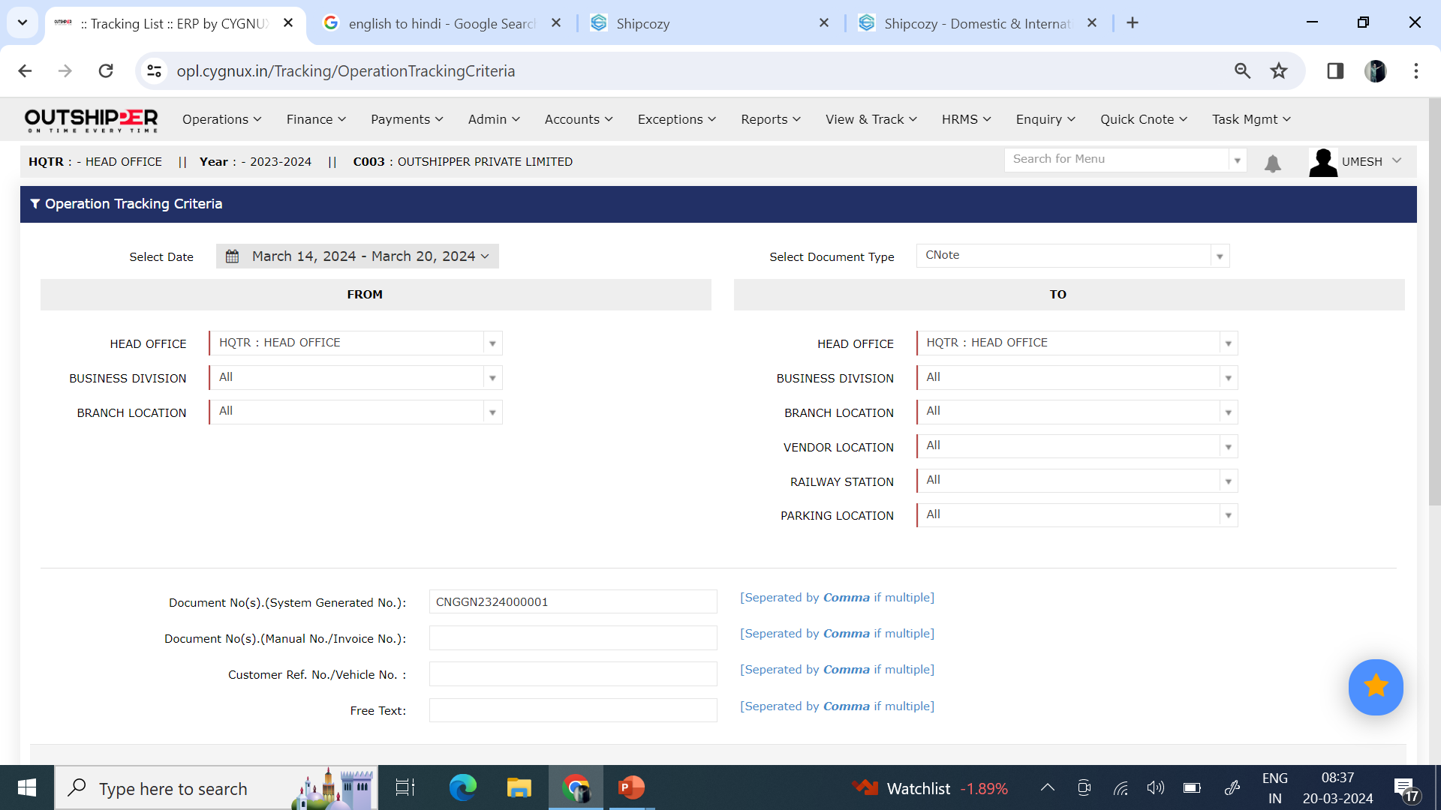
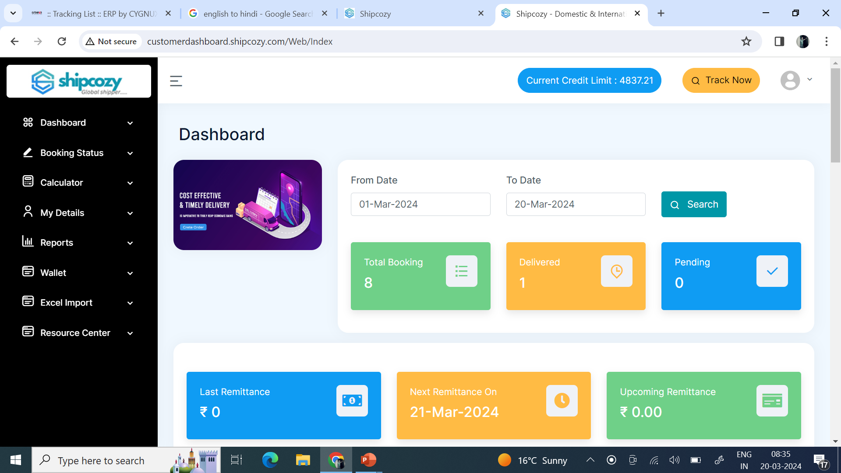
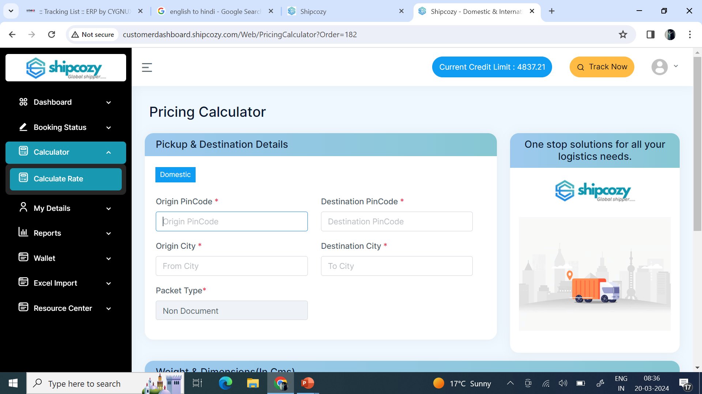
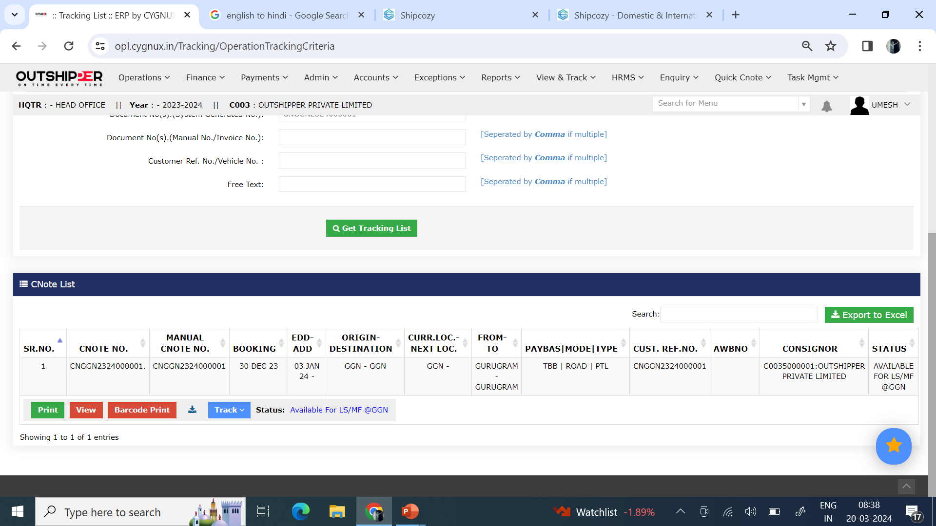
Dashboard View

Slide 8
Contact
Head office: Outshipper Private Limited
5, Captain Roshan Market , Jamalpur Haryana 122002
Phone No +91-9212399003
Branch Office: Outshipper Private Limited
c/o Ranveer Mahlawat
First floor Behind of Hotel Old Tawa Tandoor
Bilaspur Chowk Bilaspur Haryana 122413
Phone No +91-8000945818
Web: www.outshipper.in, www.shipcozy.com

